Slide 1
IPL Analysis
File created on: 2/12/2024 5:20:13 PM

Slide 2
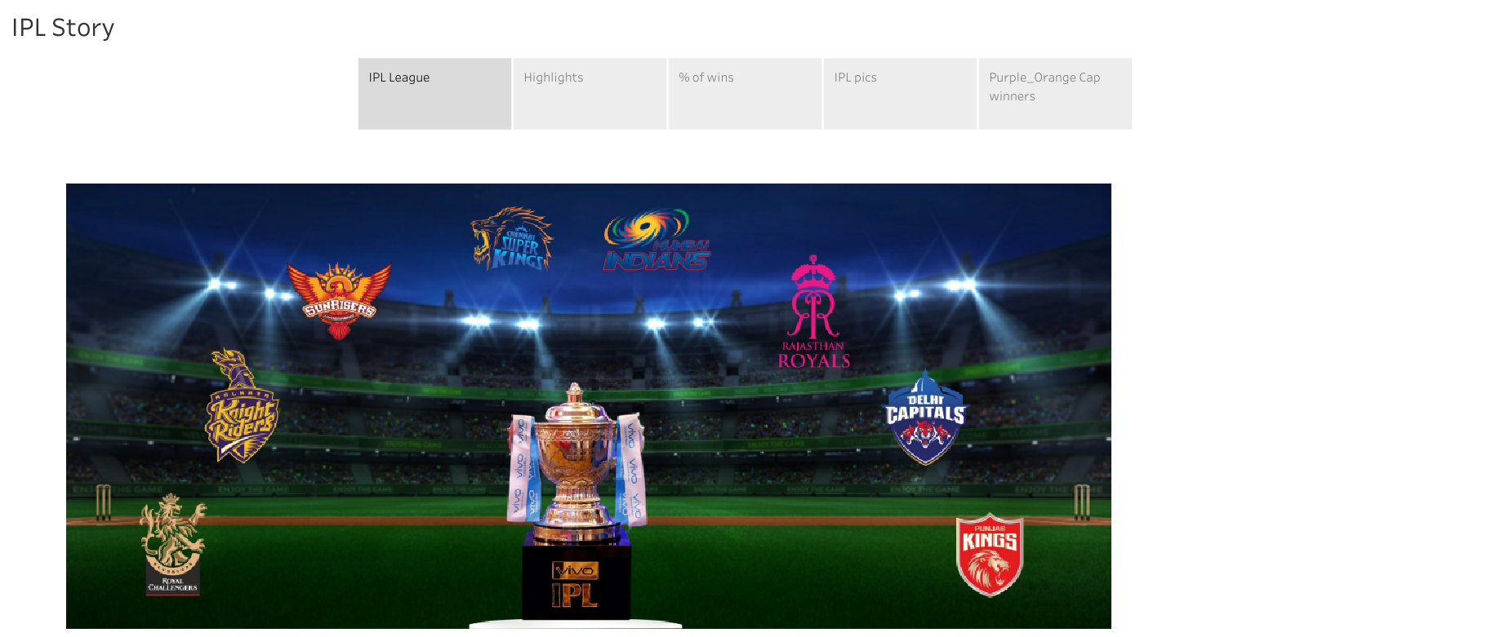

Slide 3
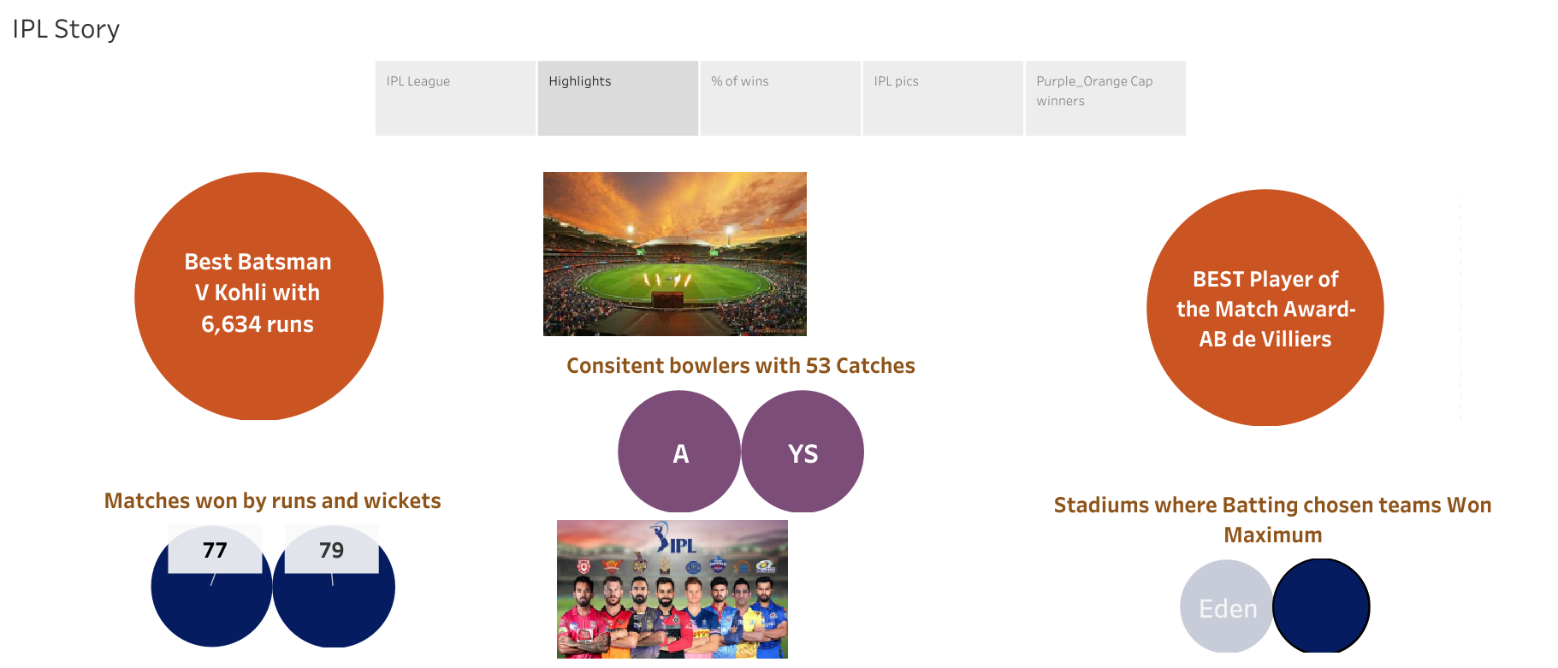

Slide 4
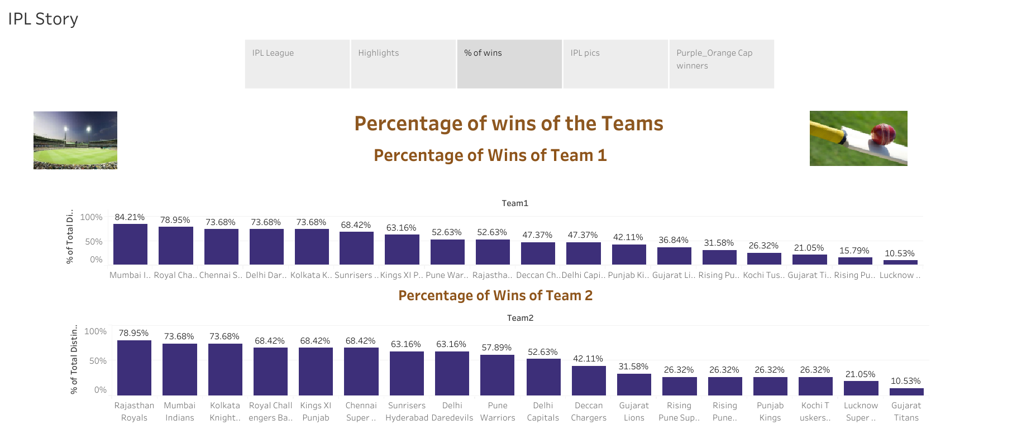

Slide 5
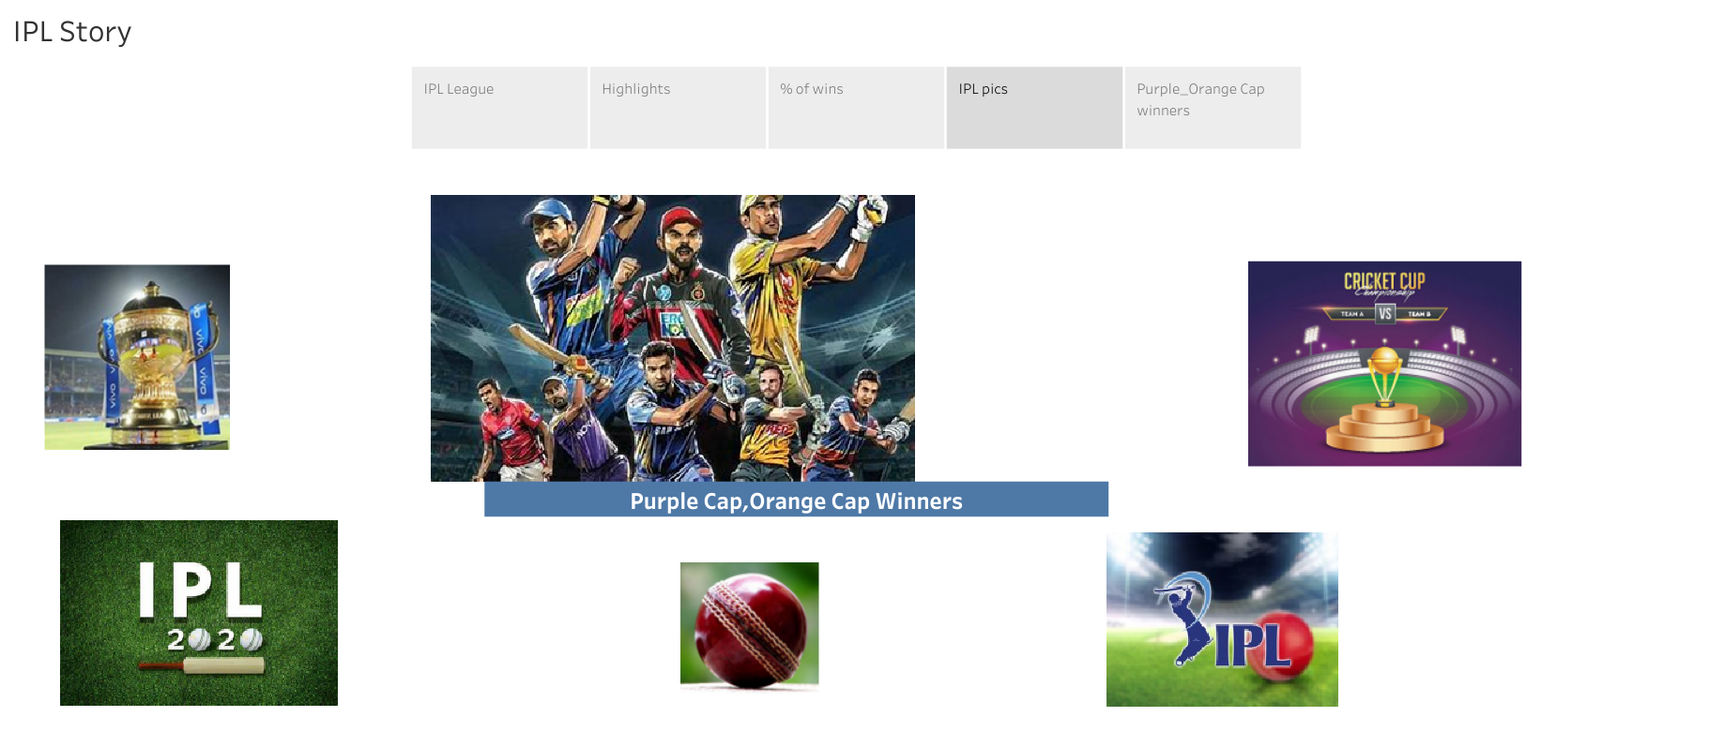

Slide 6
